Slide 1
Project Title :
Tool Development for Medical Images
by
Prakyat Prabhakar Shetty
Reg No. 221039028
Rahul SG
Reg No. 221039008
Vishal Kompalli
Reg No. 221039019
Program name:
Embedded Systems
Under the guidance of :
Assistant Prof. Ravikala Kamath
Manipal School of Information Sciences
MAHE, Manipal

Slide 2
CONTENT :
INTRODUCTION
METHODOLGY
APPROACHES
IMAGE PROCESSING RESULTS
REFERENCES

Slide 3
INTRODUCTION
Image -An image is a visual representation of something. It can be two-dimensional, three-dimensional, or somehow used in visual system to convey information.
Pixel –pixel is the smallest addressable element in a raster image, or the smallest addressable element in an all points addressable display device; so it is the smallest controllable element of a picture represented on the screen.
Colour – the property possessed by an object of producing different sensations on the eye as a result of the way it reflects or emits light.
Commonly used Formats of Images- JPEG, PNG, GIF

Slide 4
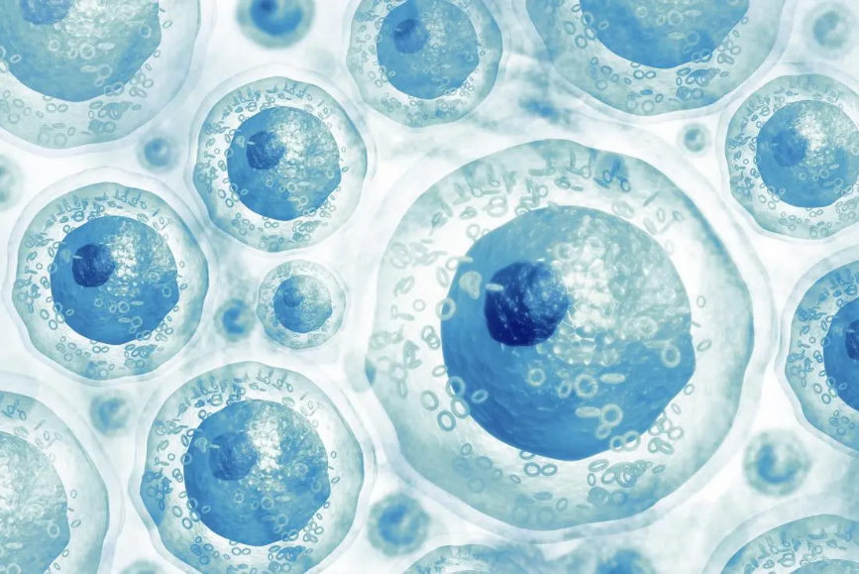
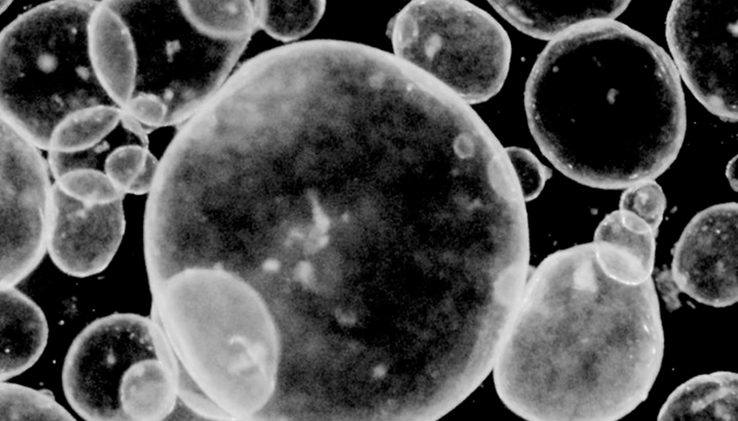
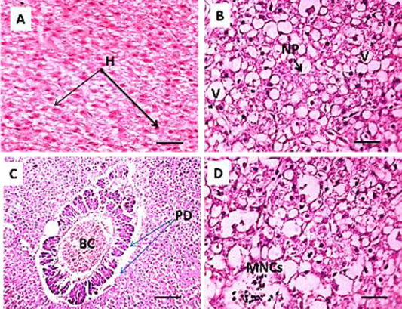
INTRODUCTION
Examples of Images:
Medical images - the diagnosis and study of diseases of the tissues, and involves examining tissues and/or cells under a microscope. These images are H&E stained images known as histopathology images.

Slide 5
METHODOLOGY
Start By Selection of an Image
Load the image on the window
Select the Process
Process the Image as per ROI
Is it the last images?
No
Yes
End and save Image

Slide 6
APPROACHES
V slicing
H Slicing
2x2
4x4
8x8
1 point ROI
2 point ROI
Clear

Slide 7
APPROACHES
V slicing: Images will be vertically sliced
H Slicing: Images will be horizontally sliced
2x2: One image gets divided into four equal parts.
4x4:One image gets divided into 16 equal parts.
8x8: One image gets divided into 64 equal parts.
1 point ROI: One point is clicked and 100 pixels is cropped.
2 point ROI: Select and drag. Click enter to crop the selected region.
Clear: Window gets cleared.

Slide 8
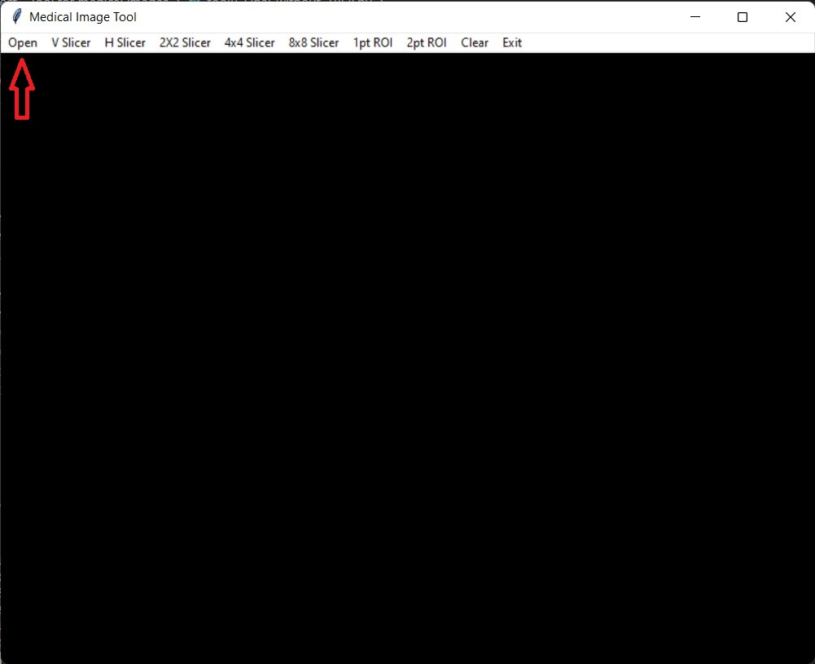
IMAGE PROCESSING RESULTS
The image shown below is the ‘Medical Image Tool’ window with options for
all the image slicing options.
Click on Open.

Slide 9
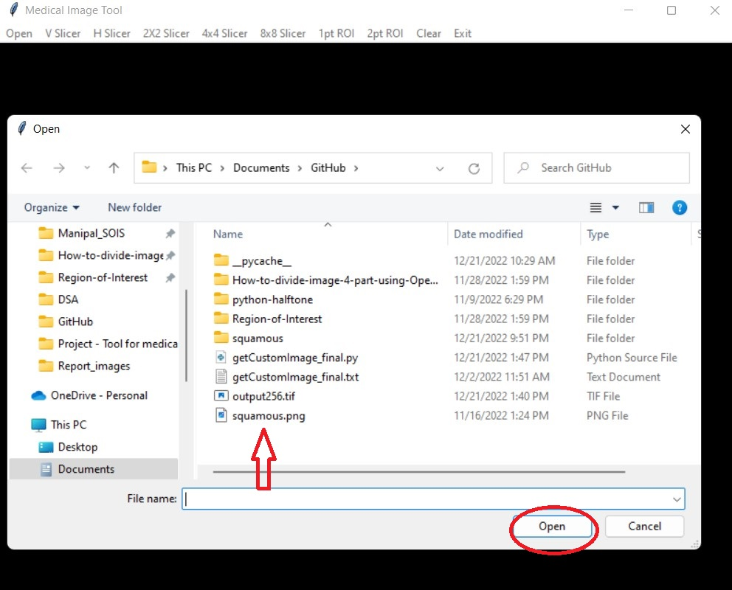
IMAGE PROCESSING RESULTS
After clicking on Open, a window will open, where we choose the image
we want to process.
Click on Open

Slide 10
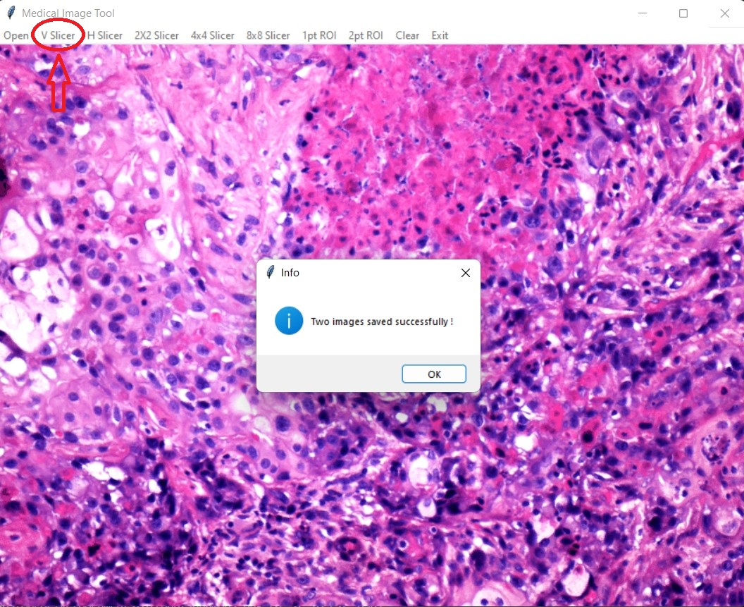
IMAGE PROCESSING RESULTS
Now, the image will open and we need to choose the required image slicing option.
And the result will be saved in the same folder as of the original image.

Slide 11
THANK YOU

Slide 12
REFERENCES
OpenCV : https://docs.opencv.org/4.x/
Pillow: https://pillow.readthedocs.io/en/stable/
Tkinter: https://docs.python.org/3/library/tkinter.html
Squamous Cell: https://treatcancer.com/blog/what-is-squamous-cell-carcinoma/

